Slide 1

CSC351-Operating System
Week-2 Lecture-3
Semester 05
                Prepared by:
                M. Shoaib

Slide 2
Preamble
In last lecture we learnt
Single-user systems
Batch systems
Multi-programmed systems
Time-sharing systems
Real-time systems
Interrupts, traps, and signals
CPU, I/O, and memory protection

Slide 3
Agenda for Today
Hardware (I/O, memory, and CPU) protection
Operating system components and services
System calls

Slide 4
Hardware Protection
Dual-Mode Operation
I/O Protection
Memory Protection
CPU Protection

Slide 5
I/O Protection
A user process may disrupt the normal operation of the system by issuing illegal I/O instructions, by accessing memory locations within the operating system itself, or by refusing to surrender the CPU.
We can use various mechanisms to ensure that such disruptions cannot take place in the system.

Slide 6
I/O Protection
All I/O instructions are privileged instructions.
Must ensure that a user program could never gain control of the computer in monitor mode (i.e., a user program that, as part of its execution, stores a new address in the interrupt vector) ex
Thus users cannot issue I/O instructions directly; they must do it through the operating system.

Slide 7
Example
Consider a computer executing in user mode. It will switch to monitor mode whenever an interrupt or trap occurs, jumping to the address determined from the interrupt from the interrupt vector. If a user program, as part of its execution, stores a new address in the interrupt vector, this new address could overwrite the previous address with an address in the user program. Then, when a corresponding trap or interrupt occurred, the hardware would switch to monitor mode and transfer control through the modified interrupt vector table to a user program, causing it to gain control of the computer in monitor mode. Hence we need all I/O instructions and instructions for changing the contents of the system space in memory to be protected. A user process could request a privileged operation
by executing a system call such as read (for reading a file).ato monitor mode and transfer control through the modified interrupt vector table to a user program, causing it to gain control of the
computer in monitor mode. Hence we need all I/O instructions and instructions for changing the contents of the system space in memory to be protected. A user process could request a privileged operation by executing a system call such as read (for reading a file).
Notes:
An interrupt vector is a table (or array) of pointers/addresses, where each entry points to the specific service routine (a piece of code) that should handle a particular type of interrupt.

Slide 8
Memory Protection
Must provide memory protection outside the address space of a process.
In order to have memory protection, add two registers that determine the range of legal addresses a program may access:
  Base register – holds the smallest legal physical memory address.
  Limit register – contains the size of the range
Memory outside the defined range is protected.

Slide 9
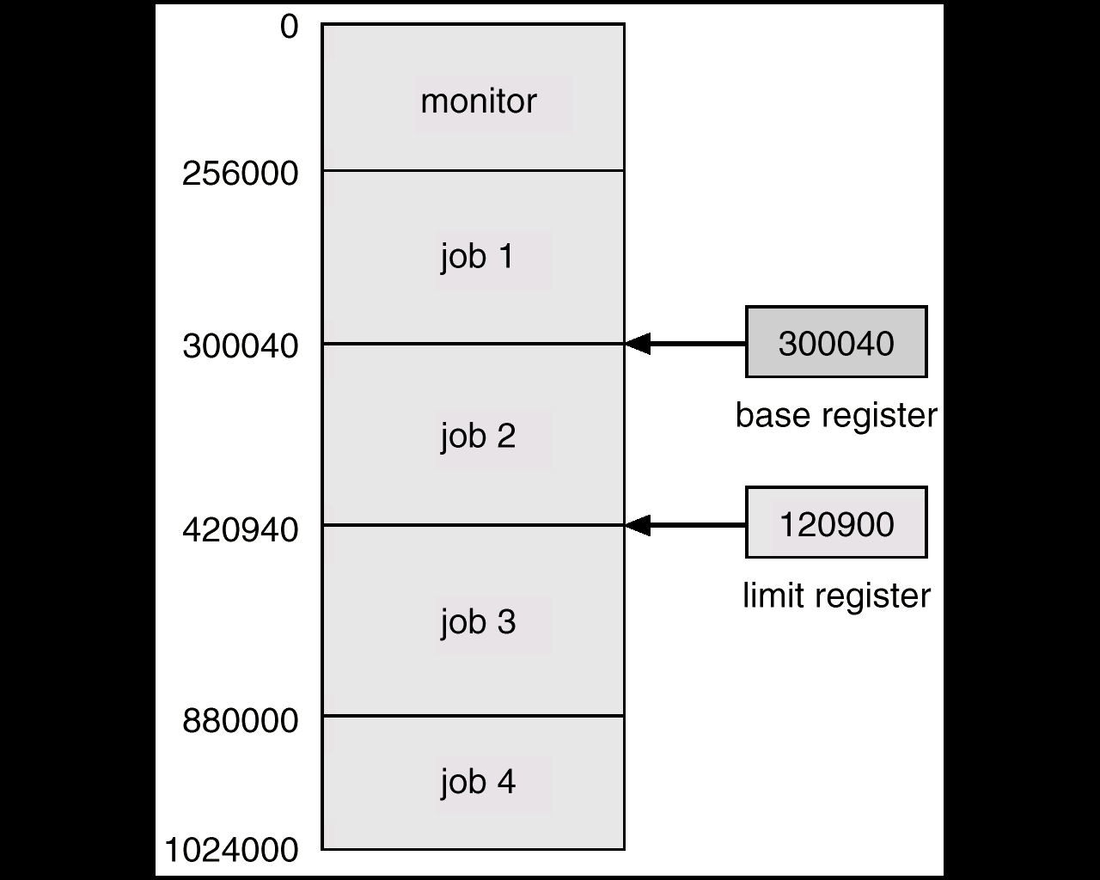
Use of Base and Limit Register

Slide 10
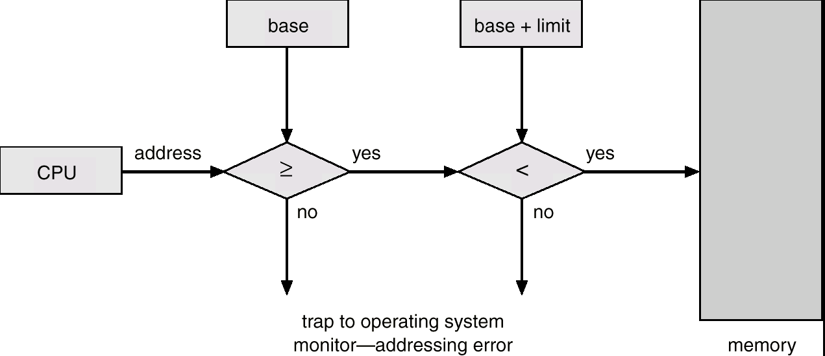
Hardware Support

Slide 11
CPU Protection
Timer – interrupts computer after specified period to ensure operating system maintains control.
  Timer is decremented every clock tick.
  When timer reaches the value 0, an interrupt occurs.
Timer commonly used to implement time sharing.
Time also used to compute the current time.
Load-timer is a privileged instruction.

Slide 12
OS Components
Process Management
Main memory management
Secondary storage management
I/O system management
File management
Protection system
Networking
Command-line interpreter (shells)

Slide 13
Process Management
The operating system is responsible for:
  Creating and terminating both user and system processes
  Suspending and resuming processes
  Providing mechanisms for process synchronization
  Providing mechanisms for process communication
  Providing mechanisms for deadlock handling

Slide 14
Memory management
The operating system is responsible for:
  Keeping track of free memory space
  Keeping track of which parts of memory are currently being used and by whom
  Deciding which processes are to be loaded into memory when memory space becomes available
  Deciding how much memory is to be allocated to a process
  Allocating and deallocating memory space as needed
  Insuring that a process is not overwritten on top of another

Slide 15
Secondary storage management
The operating system is responsible for
Free-space management
Storage allocation and deallocation
Disk scheduling

Slide 16
I/O system management
The operating system is responsible for:
A memory management component that includes buffering, caching and spooling
A general device-driver interface
Drivers(translators) for specific hardware devices
Notes:
A device driver is a piece of software that acts as a translator between the operating system and a specific piece of hardware (a printer, keyboard, disk, graphics card, USB device, etc.)

Slide 17
File management
Creating and deleting files
Creating and deleting directories
Supporting primitives (operations) for manipulating files and directories
Mapping files onto the secondary storage
Backing up files on stable (nonvolatile) storage media

Slide 18
Protection system
If a computer system has multiple users and allows concurrent execution of multiple processes then the various processes must be protected from each other’s activities.
Protection is any mechanism for controlling the access of programs, processes or users to the resources defined by a computer system.

Slide 19
Operating System Services
Services for user and users of programs
  Program execution
  I/O Operations
  File System Manipulation
  Communications between processes/users
  Error detection and handling

Slide 20
Operating System Services …
Services for efficient system operation:
Resource Allocation
When multiple users are logged on the system or multiple jobs are running at the same time, resources must be allocated to each of them. There are various routines to schedule jobs, allocate plotters, modems and other peripheral devices.
Accounting
We want to keep track of which users use how many and which kinds of computer resources. This record keeping may be used for accounting or simply for accumulating usage statistics.
Protection
The owners of information stored in a multi user computer system may want to control use of that information. When several disjointed processes execute concurrently it should not b possible for one process to interfere with the others or with the operating system itself. Protection involves ensuring that all access to system resources is controlled.

Slide 21
OS Kernel
Users
Applications
Operating System API, AUI
Operating System Kernel
Computer Hardware
Real work is done in the kernel

Slide 22
Entry Points into Kernel
System Call Signal
Interrupt Trap

Slide 23
System Calls
Programming interface to the services provided by the OS
Typically written in a high-level language (C or C++)
Mostly accessed by programs via a high-level Application Programming Interface (API) rather than direct system call use
Three most common APIs are Win32 API for Windows, POSIX API for POSIX-based systems (including virtually all versions of UNIX, Linux, and Mac OS X), and Java API for the Java virtual machine (JVM)
Note that the system-call names used throughout this text are generic

Slide 24
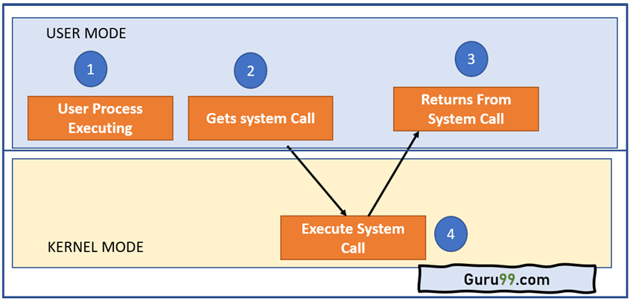
Architecture of the System Call

Slide 25
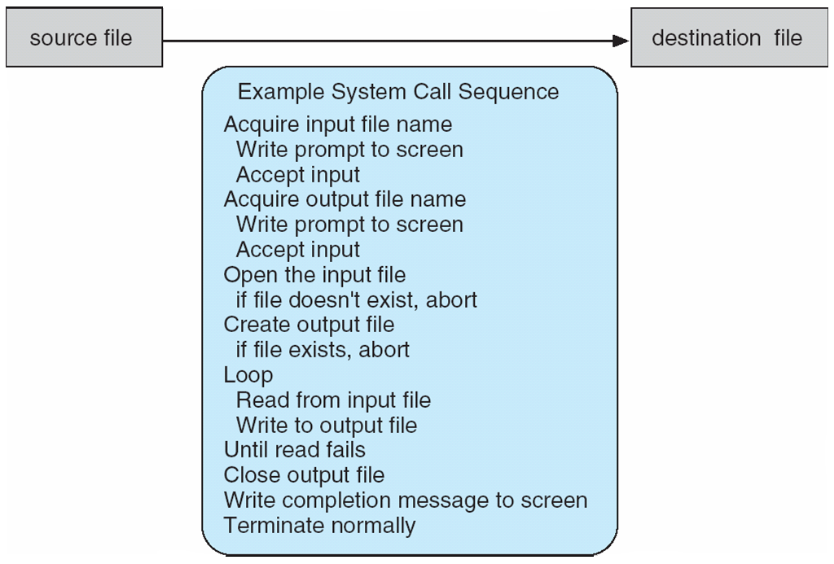
Example of System Call
System call sequence to copy the contents of one file to another file

Slide 26
System Calls
User processes must not be given open access to the kernel code
The system call interface layer contains entry point in the kernel code
Any user or application request that involves access to any system resource must be handled by the kernel code

Slide 27
System Call …
Process
Library Call
System Call
trap
Dispatch Table
Service Code
Kernel Code

Slide 28
System Call Implementation
Typically, a number associated with each system call
  System-call interface maintains a table indexed according to these numbers
The system call interface invokes the intended system call in OS kernel and returns status of the system call and any return values
The caller need know nothing about how the system call is implemented
  Just needs to obey API and understand what OS will do as a result call
  Most details of OS interface hidden from programmer by API
    Managed by run-time support library (set of functions built into libraries included with compiler)

Slide 29
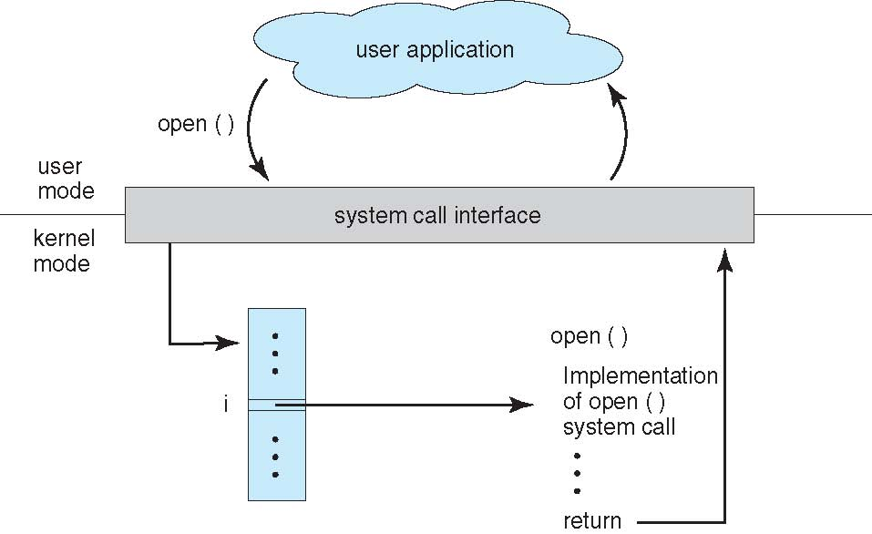
API – System Call – OS Relationship

Slide 30
Kernel in OS
Kernel is a computer program that is the heart and core of an Operating System
Kernel is responsible for low-level tasks such as disk management, memory management, task management, etc.
It provides an interface between the user and the hardware components of the system. When a process makes a request to the Kernel, then it is called System Call.

Slide 31
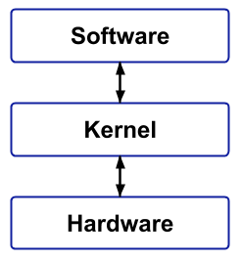
Types of Kernel
Monolithic Kernels
Monolithic Kernels are those Kernels where the user services and the kernel services are implemented in the same memory space i.e. different memory for user services and kernel services are not used in this case, Linux

Slide 32
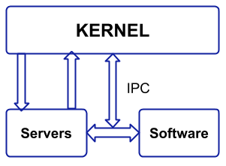
2. Microkernel
A Microkernel is different from Monolithic kernel because in a Microkernel, the user services and kernel services are implemented into different spaces i.e. we use User Space and Kernel Space in case of Microkernels.

Slide 33
Hybrid Kernel
A Hybrid Kernel is a combination of both Monolithic Kernel and Microkernel. It makes the use of the speed of Monolithic Kernel and the modularity of Microkernel.
Nanokernel
In a Nanokrnel, as the name suggests, the whole code of the kernel is very small i.e. the code executing in the privileged mode of the hardware is very small. The term nanokernel is used to describe a kernel that supports a nanosecond clock resolution.
Exokernel
In this type of kernel, the resource protection is separated from the management and this, in turn, results in allowing us to perform application-specific customization.

Slide 34
Types of System Calls
Process control
  create process, terminate process
  end, abort
  load, execute
  get process attributes, set process attributes
  wait for time
  wait event, signal event
  allocate and free memory
  Dump memory if error
  Debugger for determining bugs, single step execution
  Locks for managing access to shared data between processes

Slide 35
Types of System Calls
Process control
  create process, terminate process
  end, abort
  load, execute
  get process attributes, set process attributes
  wait for time
  wait event, signal event
  allocate and free memory
  Dump memory if error
  Debugger for determining bugs, single step execution
  Locks for managing access to shared data between processes

Slide 36
Types of System Calls
File management
  create file, delete file
  open, close file
  read, write, reposition
  get and set file attributes
Device management
  request device, release device
  read, write, reposition
  get device attributes, set device attributes
  logically attach or detach devices

Slide 37
Types of System Calls (Cont.)
Information maintenance
  get time or date, set time or date
  get system data, set system data
  get and set process, file, or device attributes
Communications
  create, delete communication connection
  send, receive messages if message passing model to host name or process name
    From client to server
  Shared-memory model create and gain access to memory regions
  transfer status information
  attach and detach remote devices

Slide 38
Types of System Calls (Cont.)
Protection
  Control access to resources
  Get and set permissions
  Allow and deny user access

Slide 39
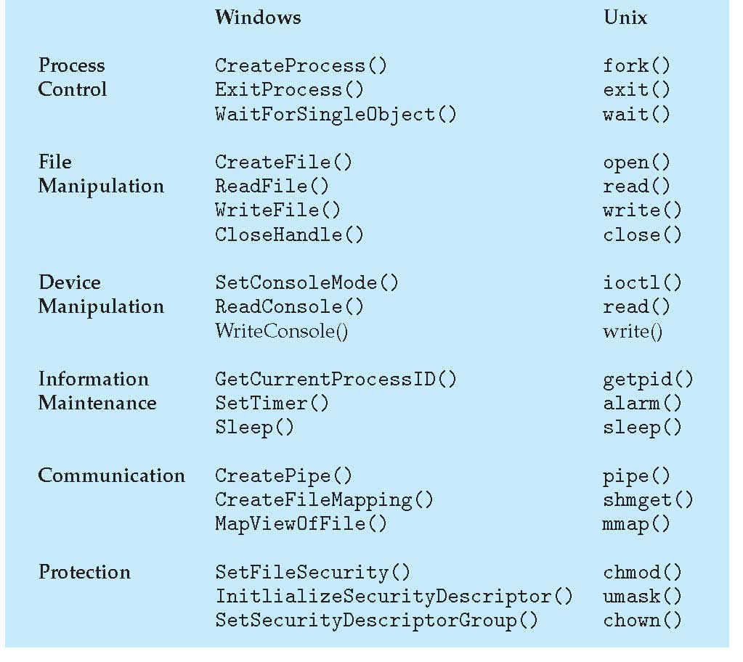
Examples of Windows and Unix System Calls

Slide 40
System Call Execution
The user program makes a call to a library function.
Library routine puts appropriate parameters at a well-known place (registers, stack, or a table in memory).
The trap instruction is executed to change mode from user to kernel.
Control goes to operating system.
Operating system determines which system call is to be carried out.

Slide 41
Semantics of System Call Execution …
Kernel indexes the dispatch table, which contains pointers to service routines for system calls.
Service routine is executed and return parameter or error code placed at well-known places (usually a CPU register).
Control given back to user program.
Library function executes the instruction following trap.

Slide 42
Task
What is kernel and explain its types.(Monolithic Kernels, Microkernel, Hybrid Kernel).

Slide 43
Summary
Today we learnt
Hardware (I/O, memory, and CPU) protection
Operating system components and services
System calls

